Slide 1
Prerequisites:
Automata Theory: DFAs, NFAs, Regular Expressions
Textbook:
Alfred V. Aho, Ravi Sethi, and Jeffrey D. Ullman,
“Compilers: Principles, Techniques, and Tools”
Addison-Wesley, 1986.
Ref. Book:
K. Cooper, L. Torczon, ‘Engineering a Compiler’, Morgan Kaufmann, 1st Edition, 2003
Compiler Design 40306

Slide 2
Translators
Programs written in high-level languages need to be translated into low-level (machine code) for processing and execution by the CPU. This is done by a translator program.
There are two types of translator program:
interpreters
compilers
Compiler Design 40306

Slide 3
COMPILERS
A compiler is a program takes a program written in a source language and translates it into an equivalent program in a target language.
source program COMPILER target program
error messages
( Normally a program written in
a high-level programming language)
( Normally the equivalent program in
machine code – relocatable object file)
Compiler Design 40306

Slide 4
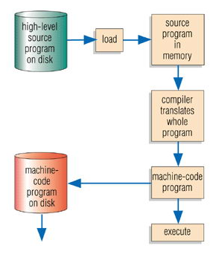
Compilers
A Compiler program translates the whole program into a machine code version that can be run without the compiler being present.
Advantage: program runs fast as already in machine code, translator program only needed at the time of compiling
Disadvantage: slow to compile as whole program translated
Compiler Design 40306

Slide 5
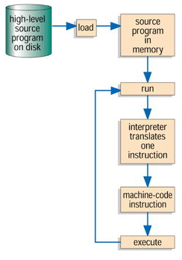
Interpreters
Interpreter program translates HLL code into machine code one line at a time.
Advantage: easy to find errors, better for learners
Disadvantage: program runs slow as have to be continually interpreted, interpreter program always in memory to interpret program.
Compiler Design 40306

Slide 6
Other Applications
In addition to the development of a compiler, the techniques used in compiler design can be applicable to many problems in computer science.
  Techniques used in a lexical analyzer can be used in text editors, information retrieval system, and pattern recognition programs.
  Techniques used in a parser can be used in a query processing system such as SQL.
  A symbolic equation solver which takes an equation as input. That program should parse the given input equation.
  Most of the techniques used in compiler design can be used in Natural Language Processing (NLP) systems.
Compiler Design 40306

Slide 7
Major Parts of Compilers
There are two major parts of a compiler: Analysis and Synthesis
In analysis phase, an intermediate representation is created from the given source program.
In synthesis phase, the equivalent target program is created from this intermediate representation.
Compiler Design 40306

Slide 8
Phases of A Compiler
Source
Program
Lexical
Analyzer
Syntax
Analyzer
Semantic
Analyzer
Intermediate
Code Generator
Code
Optimizer
Code
Generator
Target
Program
Each phase transforms the source program from one representation into another representation.
They communicate with error handlers.
They communicate with the symbol table.
Compiler Design 40306

Slide 9
1. Lexical Analyzer
Lexical Analyzer reads the source program character by character and returns the tokens of the source program.
A token describes a pattern of characters having same meaning in the source program. (such as identifiers, operators, keywords, numbers, delimeters and so on)
Ex: newval := oldval + 12 => tokens: newval identifier
:= assignment operator
oldval identifier
+ add operator
12 a number
Puts information about identifiers into the symbol table.
Regular expressions are used to describe tokens (lexical constructs).
A (Deterministic) Finite State Automaton can be used in the implementation of a lexical analyzer.
Compiler Design 40306

Slide 10
2. Syntax Analyzer
A Syntax Analyzer creates the syntactic structure (generally a parse tree) of the given program.
A syntax analyzer is also called as a parser.
A parse tree describes a syntactic structure.
assgstmt
identifier := expression
newval expression + expression
identifier number
oldval 12
In a parse tree, all terminals are at leaves.
All inner nodes are non-terminals in
a context free grammar.
Compiler Design 40306

Slide 11
Syntax Analyzer
The syntax of a language is specified by a context free grammar (CFG).
The rules in a CFG are mostly recursive.
A syntax analyzer checks whether a given program satisfies the rules implied by a CFG or not.
  If it satisfies, the syntax analyzer creates a parse tree for the given program.
Ex: We use BNF (Backus Naur Form) to specify a CFG
assgstmt -> identifier := expression
expression -> identifier
expression -> number
expression -> expression + expression
Compiler Design 40306

Slide 12
Syntax Analyzer versus Lexical Analyzer
Which constructs of a program should be recognized by the lexical analyzer, and which ones by the syntax analyzer?
  Both of them do similar things; But the lexical analyzer deals with the simple non-recursive constructs of the language.
  The syntax analyzer deals with the recursive constructs of the language.
  The lexical analyzer simplifies the job of the syntax analyzer.
  The lexical analyzer recognizes the smallest meaningful units (tokens) in a source program.
  The syntax analyzer works on the smallest meaningful units (tokens) in a source program to recognize meaningful structures in our programming language.
Compiler Design 40306

Slide 13
Parsing Techniques
Depending on how the parse tree is created, there are different parsing techniques.
These parsing techniques are categorized into two groups:
  Top-Down Parsing,
  Bottom-Up Parsing
Top-Down Parsing:
  Construction of the parse tree starts at the root, and proceeds towards the leaves.
  Efficient top-down parsers can be easily constructed by hand.
  Recursive Predictive Parsing, Non-Recursive Predictive Parsing (LL Parsing).
Bottom-Up Parsing:
  Construction of the parse tree starts at the leaves, and proceeds towards the root.
  Normally efficient bottom-up parsers are created with the help of some software tools.
  Bottom-up parsing is also known as shift-reduce parsing.
  Operator-Precedence Parsing – simple, restrictive, easy to implement
  LR Parsing – much general form of shift-reduce parsing, LR, SLR, LALR
Compiler Design 40306

Slide 14
3. Semantic Analyzer
A semantic analyzer checks the source program for semantic errors and collects the type information for the code generation.
Type-checking is an important part of semantic analyzer.
Context-free grammars used in the syntax analysis are integrated with attributes (semantic rules)
  the result is a syntax-directed translation,
  Attribute grammars
Ex:
  newval := oldval + 12
    The type of the identifier newval must match with type of the expression (oldval+12)
Compiler Design 40306

Slide 15
4. Intermediate Code Generation
A compiler may produce an explicit intermediate codes representing the source program.
These intermediate codes are generally machine (architecture) independent. But the level of intermediate codes is closer to the level of machine codes.
Ex:
  newval := oldval * fact + 1
  id1 := id2 * id3 + 1
  temp1 := id2 * id3 Intermediates Codes (three address code)
  temp2 := temp1 + 1
  id1 := temp2
Compiler Design 40306

Slide 16
Intermediate Code Generation
Properties of IR-
Easy to produce
Easy to translate into the target program
IR can be in the following forms-
Syntax trees
Postfix notation
Three address statements
Properties of three address statements-
At most one operator in addition to an assignment operator
Must generate temporary names to hold the value computed at each
instruction
Some instructions have fewer than three operands
Compiler Design 40306

Slide 17
5. Code Optimizer (for Intermediate Code Generator)
The code optimizer optimizes the code produced by the intermediate code generator in the terms of time and space.
Ex:
  temp1 := id2 * id3
  id1 := temp1 + 1
Compiler Design 40306

Slide 18
6. Code Generator
Produces the target language in a specific architecture.
The target program is normally a relocatable object file containing the machine code or assembly code.
Intermediate instructions are each translated into a sequence of machine instructions that perform the same task.
Ex:
( assume that we have an architecture with instructions whose at least one of its operands is
a machine register)
  MOVE id2,R1
  MULT id3,R1
  ADD #1,R1
  MOVE R1,id1
Compiler Design 40306

Slide 19
Phases of compiler
Compiler Design 40306

Slide 20
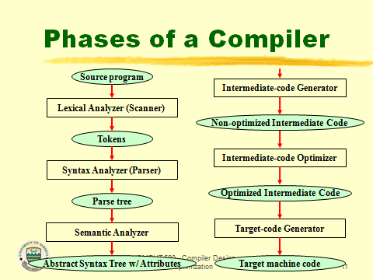
Compiler Design 40306

Slide 21
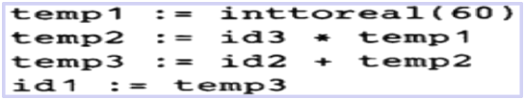

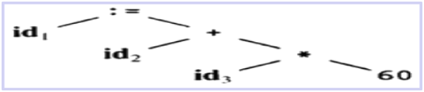
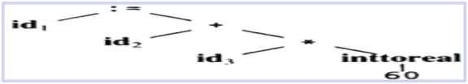
The Structure of a Compiler
Code Generator
[Intermediate Code Generator]
Non-optimized Intermediate Code
Scanner
[Lexical Analyzer]
Tokens
Code Optimizer
Parser
[Syntax Analyzer]
Optimized Intermediate Code
Parse tree
Code Genrator
Semantic Process
[Semantic analyzer]
Target machine code
Abstract Syntax Tree w/ Attributes
Compiler Design 40306

Slide 22
The input program as you see it. main ()
{ int i,sum; sum = 0; for (i=1; i<=10; i++); sum = sum + i; printf("%d\n",sum);
}
Compiler Design 40306

Slide 23
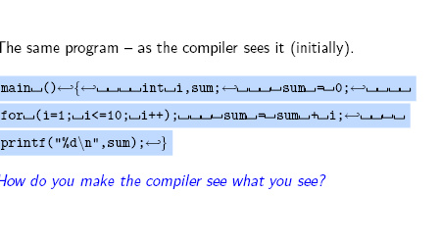
Compiler Design 40306

Slide 24
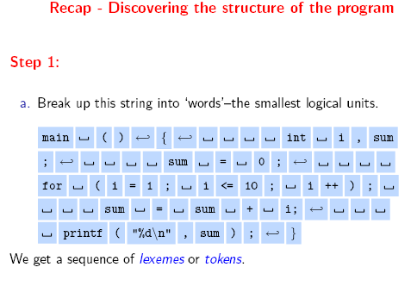
Compiler Design 40306

Slide 25
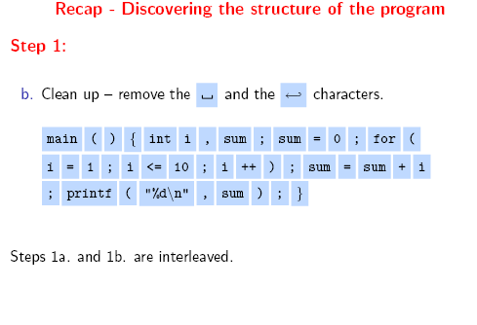
Compiler Design 40306

Slide 26
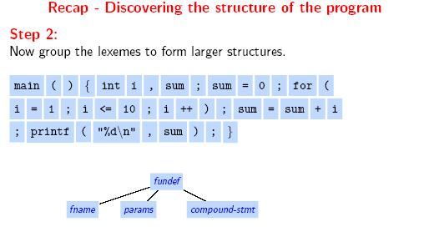
Compiler Design 40306

Slide 27
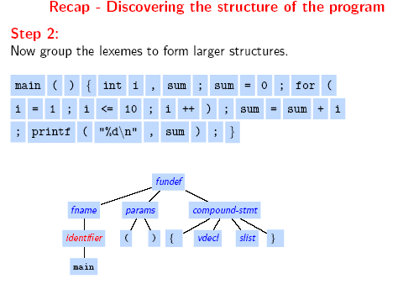
Compiler Design 40306

Slide 28
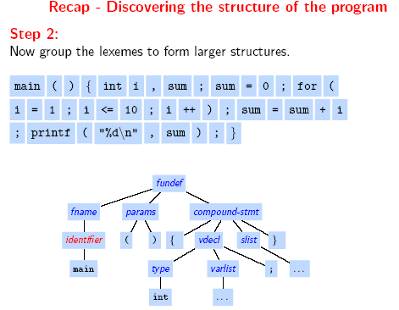
Compiler Design 40306

Slide 29
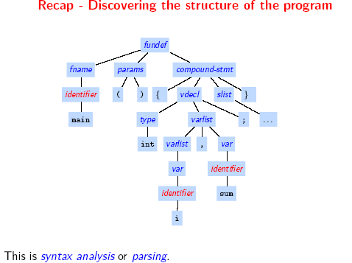
Compiler Design 40306

Slide 30
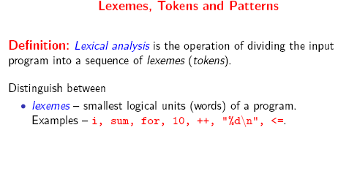
Compiler Design 40306

Slide 31
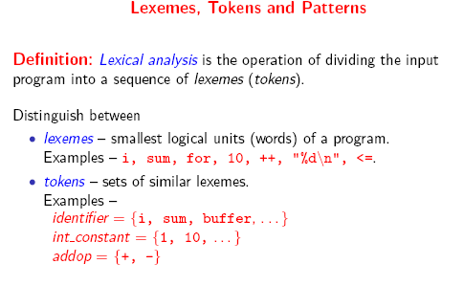
Compiler Design 40306

Slide 32
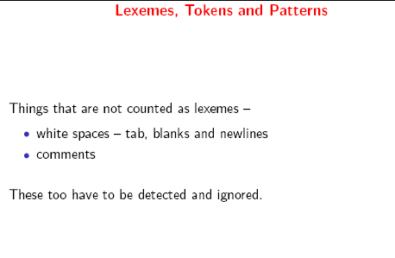
Compiler Design 40306

Slide 33
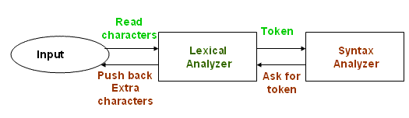
Role of the Lexical Analyzer
Compiler Design 40306

Slide 34
Tasks of Lexical Analyzer
Reads source text and detects the token
Stripe out comments, white spaces, tab, newline characters.
Correlates error messages from compilers to source program
Approaches to implementation
. Use assembly language- Most efficient but most difficult to implement
. Use high level languages like C- Efficient but difficult to implement
. Use tools like lex, flex- Easy to implement but not as efficient as the first
two cases
Compiler Design 40306

Slide 35
Lexical Analyzer in Perspective
LEXICAL ANALYZER
  Scan Input
  Remove WS, NL, …
  Identify Tokens
  Create Symbol Table
  Insert Tokens into ST
  Generate Errors
  Send Tokens to Parser
PARSER
  Perform Syntax Analysis
  Actions Dictated by Token Order
  Update Symbol Table Entries
  Create Abstract Rep. of Source
  Generate Errors
  And More…. (We’ll see later)
Compiler Design 40306

Slide 36
What Factors Have Influenced the Functional Division of Labor ?
Separation of Lexical Analysis From Parsing Presents a Simpler Conceptual Model
  A parser embodying the conventions for comments and white space is significantly more complex that one that can assume comments and white space have already been removed by lexical analyzer.
Separation Increases Compiler Efficiency
  Specialized buffering techniques for reading input characters and processing tokens…
Separation Promotes Portability.
  Input alphabet peculiarities and other device-specific anomalies can be restricted to the lexical analyzer.
Compiler Design 40306

Slide 37
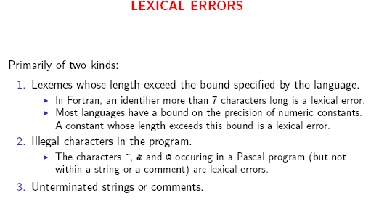
Compiler Design 40306

Slide 38
  Handling Lexical Errors
  In what Situations do Errors Occur?
  Lexical analyzer is unable to proceed because none of the patterns for tokens matches a prefix of remaining input.
  For example:
  fi ( a == f(x) )….
  1) Panic mode recovery - deleting successive characters until a well formed token is formed.
  2) Inserting a missing character
  3) Replacing a missing character by a correct character
  4) Transposing two adjacent characters.
  5) Deleting an extraneous character
Compiler Design 40306

Slide 39
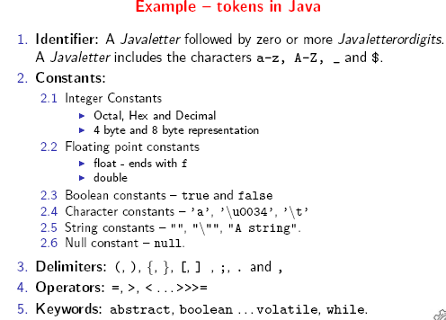
Compiler Design 40306

Slide 40
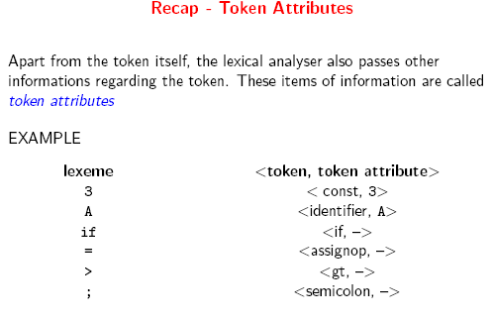
Compiler Design 40306

Slide 41
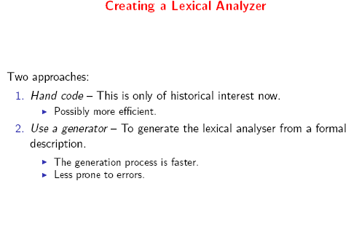
Compiler Design 40306

Slide 42
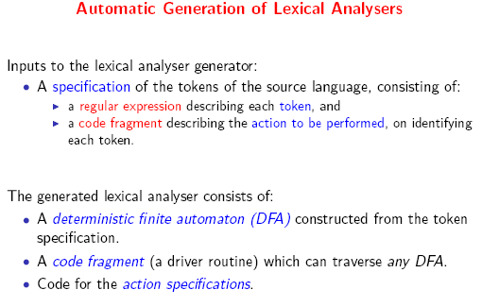
Compiler Design 40306

Slide 43
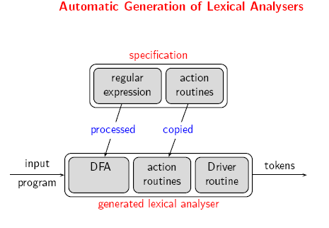
Compiler Design 40306

Slide 44
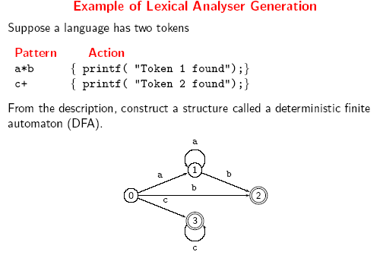
Compiler Design 40306

Slide 45
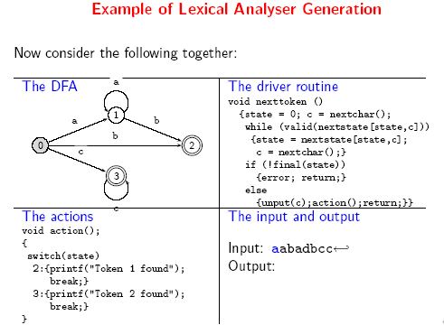
Compiler Design 40306

Slide 46
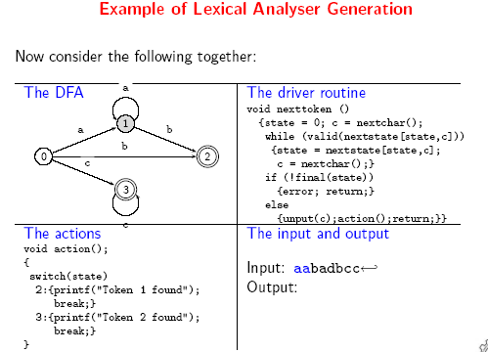
Compiler Design 40306

Slide 47

Compiler Design 40306

Slide 48
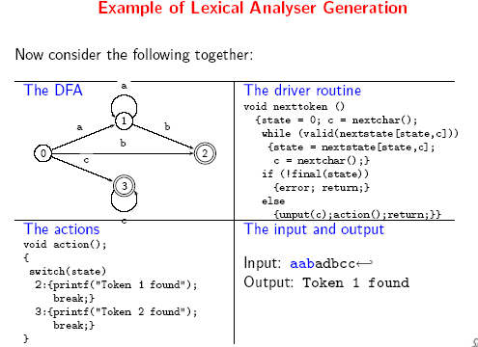
Compiler Design 40306

Slide 49
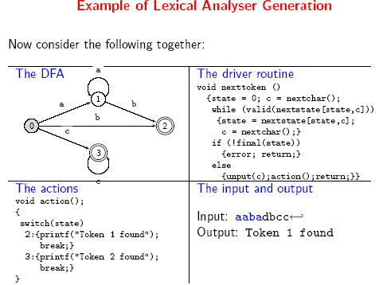
Compiler Design 40306

Slide 50
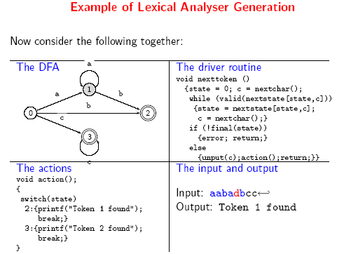
Compiler Design 40306

Slide 51
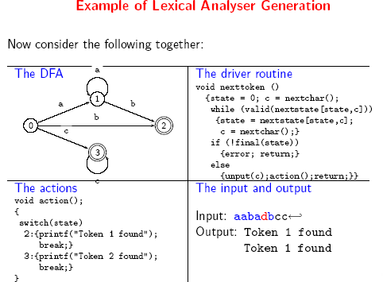
Compiler Design 40306

Slide 52
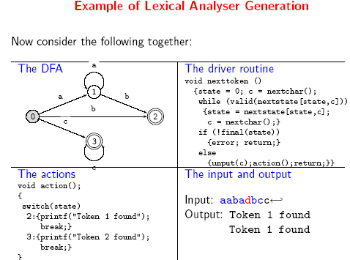
Compiler Design 40306

Slide 53
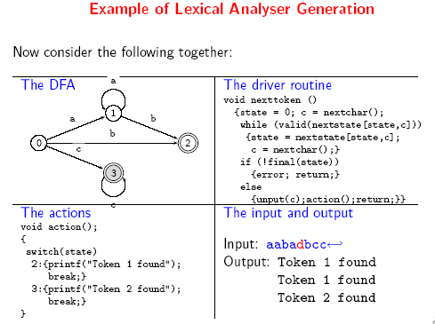
Compiler Design 40306

Slide 54
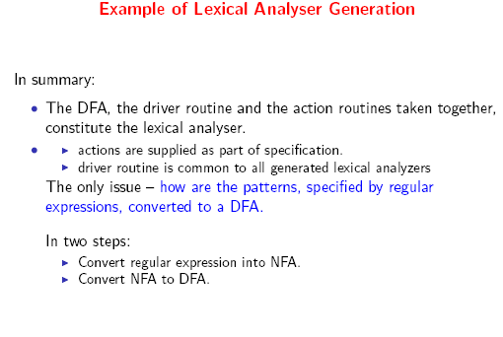
Compiler Design 40306

Slide 55
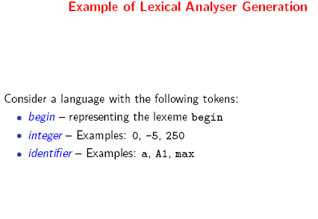
Compiler Design 40306

Slide 56
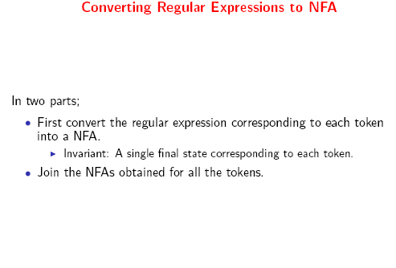
Compiler Design 40306

Slide 57
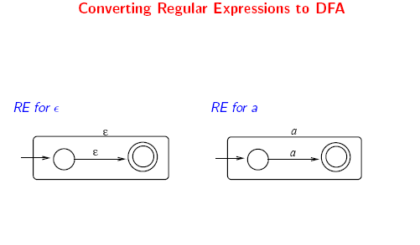
Compiler Design 40306

Slide 58
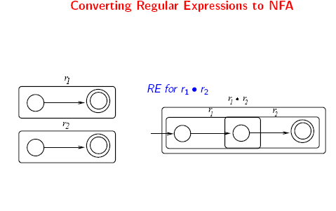
Compiler Design 40306

Slide 59
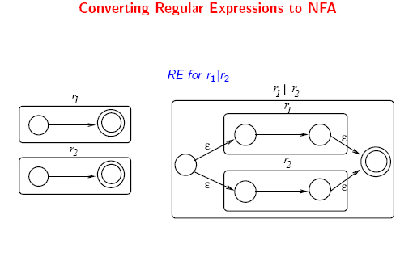
Compiler Design 40306

Slide 60
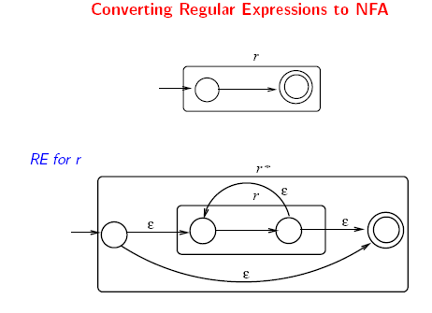
Compiler Design 40306

Slide 61
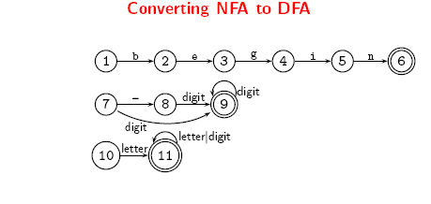
Compiler Design 40306

Slide 62
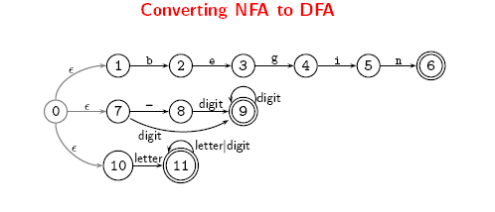
Compiler Design 40306

Slide 63
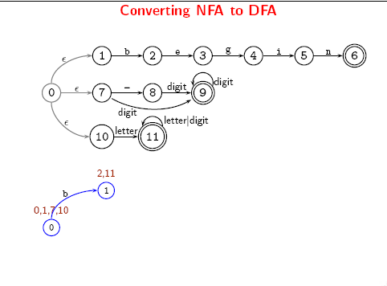
Compiler Design 40306

Slide 64
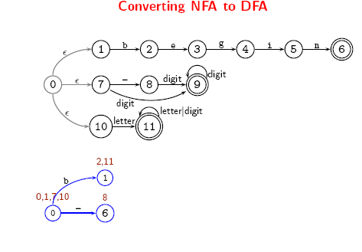
Compiler Design 40306

Slide 65
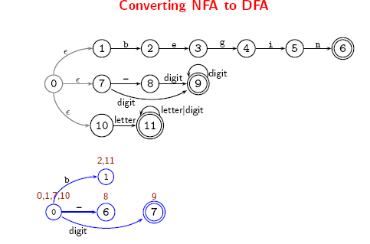
Compiler Design 40306

Slide 66
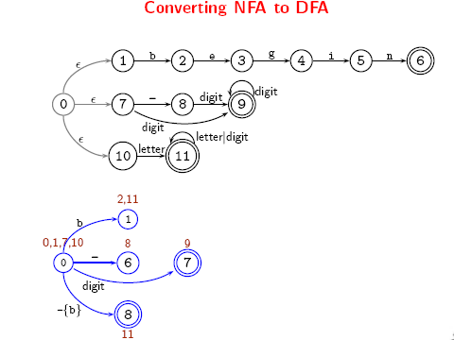
Compiler Design 40306

Slide 67
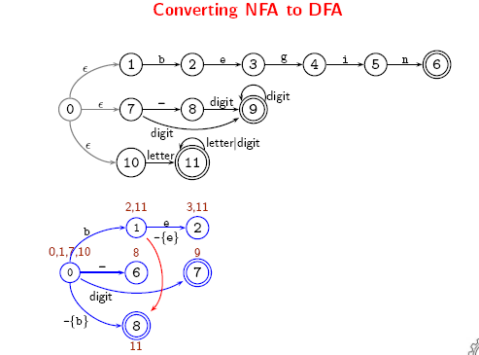
Compiler Design 40306

Slide 68
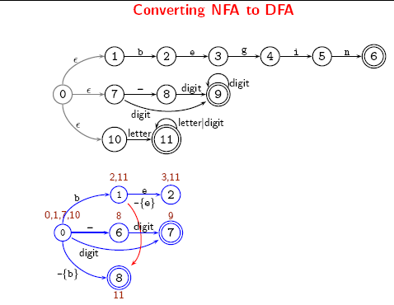
Compiler Design 40306

Slide 69
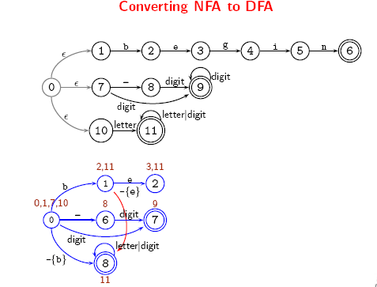
Compiler Design 40306

Slide 70
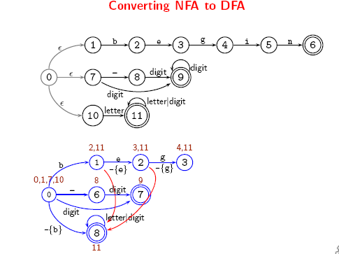
Compiler Design 40306

Slide 71
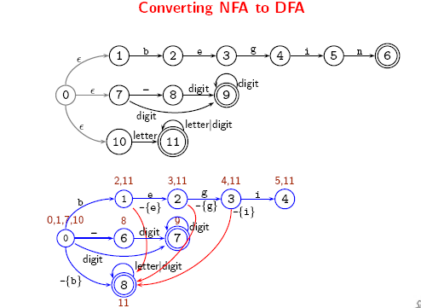
Compiler Design 40306

Slide 72

Compiler Design 40306

Slide 73

Compiler Design 40306

Slide 74

Compiler Design 40306

Slide 75

Compiler Design 40306

Slide 76

Compiler Design 40306

Slide 77

Compiler Design 40306

Slide 78
Direct Simulation of an NFA
s ← s₀
c ← nextchar;
while c ≠ eof do
s ← move(s,c);
c ← nextchar;
end;
if s is in F then return “yes”
else return “no”
DFA
simulation
S ← ∈-closure({s₀})
c ← nextchar;
while c ≠ eof do
S ← ∈-closure(move(S,c));
c ← nextchar;
end;
if S∩F≠∅ then return “yes”
else return “no”
NFA
simulation

Slide 79
Pattern Matching Based on NFA (1)
P₁ : a {action}
P₂ : abb {action}
P₃ : a*b⁺ {action}
3 patterns
NFA’s :
P₁
start
a
1
2
P₂
start
a
b
b
3
4
5
6
a
b
P₃
start
7
8
b
Compiler Design 40306

Slide 80
Pattern Matching Based on NFA continued (2)
Combined NFA :
a
P₁
1
2
∈
start
∈
a
b
b
P₂
0
3
4
5
6
∈
a
b
P₃
7
8
b
Examples a a b a
{0,1,3,7} {2,4,7} {7} {8} death
pattern matched: - P₁ - P₃ -
a b b
{0,1,3,7} {2,4,7} {5,8} {6,8}
pattern matched: - P₁ P₃ P₂,P₃ ⇐
break tie in favor of P₂
Compiler Design 40306

Slide 81
DFA for Lexical Analyzers
Alternatively Construct DFA:
keep track of correspondence between patterns and new accepting states
Input Symbol
STATE
a
b
Pattern
{0,1,3,7}
{2,4,7}
{8}
none
{2,4,7}
{7}
{5,8}
P₁
{8}
-
{8}
P₃
{7}
{7}
{8}
none
{5,8}
-
{6,8}
P₃
break tie in favor of P₂
{6,8}
-
{8}
P₂
Compiler Design 40306

Slide 82
Example
Input: aaba
{0,1,3,7}
{2,4,7}
{7}
{8}
Input: aba
{0,1,3,7}
{2,4,7}
{5,8}
P₃
Input Symbol
STATE
a
b
Pattern
{0,1,3,7}
{2,4,7}
{8}
none
{2,4,7}
{7}
{5,8}
P₁
{8}
-
{8}
P₃
{7}
{7}
{8}
none
{5,8}
-
{6,8}
P₃
{6,8}
-
{8}
P₂
Compiler Design 40306

Slide 83
Example- TD Based Lexical Analyzers
<= :
start
<
=
RTN(LE)
0
6
7
other
*
RTN(LT)
8
We’ve accepted “<” and have read other char that must be unread.
DRAW a TD for {<=,<>,=,>=,>}.
Compiler Design 40306

Slide 84
Example : All RELOPs
start
<
=
0
1
2
return(relop, LE)
>
3
return(relop, NE)
other
*
=
4
return(relop, LT)
5
return(relop, EQ)
>
=
6
7
return(relop, GE)
other
*
8
return(relop, GT)
Compiler Design 40306

Slide 85
IDENTIFIER
letter or digit
letter
other
9
10
11
Compiler Design 40306

Slide 86
INTEGER
digit
*
digit
other
25
26
27

Slide 87
Implementing Transition Diagrams
int state = 0, start = 0
lexeme_beginning = forward;
token nexttoken()
{ while(1) {
switch (state) {
case 0: c = nextchar();
if (c == ‘<‘) state = 1;
else if (c == ‘=‘) state = 5;
else if (c == ‘>’) state = 6;
else state = fail();
case 1: .....
...
case 8: .......
}
}
}
start
0
<
1
=
2
>
3
other
=
4
*
repeat
until
a “return”
or failure occurs
5
>
6
=
7
other
*
8
Compiler Design 40306

Slide 88
Implementing Transition Diagrams
int state = 0, start = 0
lexeme_beginning = forward;
token nexttoken()
{ while(1) {
switch (state) {
case 0: c = nextchar();
if (c == ‘<‘) state = 1;
else if (c == ‘=‘) state = 5;
else if (c == ‘>’) state = 6;
else state = fail();
case 1: .....
...
case 8: retract();
retToken.attribute = GT;
return(RELOP);
}
}
}
start
0
<
1
=
2
>
3
other
=
4
*
repeat
until
a “return”
or failure occurs
5
>
6
=
7
other
*
8
Compiler Design 40306

Slide 89
Implementing Transition Diagrams
A sequence of transition diagrams can be converted into a program to look for the tokens specified by the grammar
Each state gets a segment of code
FUNCTIONS USED
  nextchar(),
  retract(),
  install_num(),
  install_id(),
  gettoken(),
  isdigit(),
  isletter(),
  recover()

Slide 90
Implementing Transition Diagrams, I
int state = 0, start = 0
lexeme_beginning = forward;
token nexttoken()
{ while(1) {
switch (state) {
case 0: c = nextchar();
/* c is lookahead character */
if (c== blank || c==tab || c== newline) {
state = 0;
lexeme_beginning++;
/* advance
beginning of lexeme */
}
else if (c == ‘<‘) state = 1;
else if (c == ‘=‘) state = 5;
else if (c == ‘>’) state = 6;
else state = fail();
break;
… /* cases 1-8 here */
repeat
until
a “return”
occurs
start
0
<
1
=
2
>
3
other
=
4
*
5
>
6
=
7
other
*
8

Slide 91
Implementing Transition Diagrams, II
.............
case 9: c = nextchar();
if (isletter(c)) state = 10;
else state = fail();
break;
case 10; c = nextchar();
if (isletter(c)) state = 10;
else if (isdigit(c)) state = 10;
else state = 11;
break;
case 11; retract(1); lexical_value = install_id();
return ( gettoken(lexical_value) );
.............
letter or digit
*
letter
other
reads token
name from ST
9
10
11

Slide 92
Implementing Transition Diagrams, III
digit
*
digit
other
25
26
27
advances
forward
.............
case 25; c = nextchar();
if (isdigit(c)) state = 26;
else state = fail();
break;
case 26; c = nextchar();
if (isdigit(c)) state = 26;
else state = 27;
break;
case 27; retract(1); lexical_value = install_num();
return ( NUM );
.............
Case numbers correspond to transition diagram states !
looks at the region
lexeme_beginning ... forward
retracts
forward

Slide 93
When Failures Occur:
int fail()
{
forward = lexeme beginning;
switch (start) {
case 0: start = 9; break;
case 9: start = 12; break;
case 12: start = 20; break;
case 20: start = 25; break;
case 25: recover(); break;
default: /* lex error */
}
return start;
}
Switch to
next transition
diagram

Slide 94
Buffer Pairs
Lexical analyzer needs to look ahead several characters beyond the lexeme for a pattern before a match can be announced.
Use a function ungetc to push lookahead characters back into the input stream.
Large amount of time can be consumed moving characters.
Special Buffering Technique
Use a buffer divided into two N-character halves
N = Number of characters on one disk block
One system command read N characters
Fewer than N character => eof
Compiler Design 40306

Slide 95
Buffer Pairs (2)
Two pointers to the input buffer are maintained
The string of characters between the pointers is the current lexeme
Once the next lexeme is determined, the forward pointer is set to the character at its right end.
E
=
M
*
C
*
*
2
eof
lexeme beginning
forward (scans ahead to find pattern match)
Comments and white space can be treated as patterns that yield no token
Compiler Design 40306

Slide 96
Code to advance forward pointer
if forward at the end of first half then begin
  reload second half ;
forward : = forward + 1;
end
else if forward at end of second half then begin
reload first half ;
move forward to beginning of first half
end
else forward : = forward + 1;
Compiler Design 40306

Slide 97
Algorithm: Buffered I/O with Sentinels
Current token
E
=
M
*
eof
C
*
*
2
eof
eof
lexeme beginning
forward (scans ahead to find pattern match)
forward : = forward + 1 ;
if forward ↑ = eof then begin
if forward at end of first half then begin
reload second half ;
forward : = forward + 1
end
else if forward at end of second half then begin
reload first half ;
move forward to biginning of first half
end
else / * eof within buffer signifying end of input * /
terminate lexical analysis
end
Algorithm performs
I/O’s. We can still
have get & ungetchar
Now these work on
real memory buffers !
Block I/O
Block I/O
2nd eof ⇒ no more input !
Compiler Design 40306

Slide 98
Questions?
Compiler Design 40306

